Slide 1
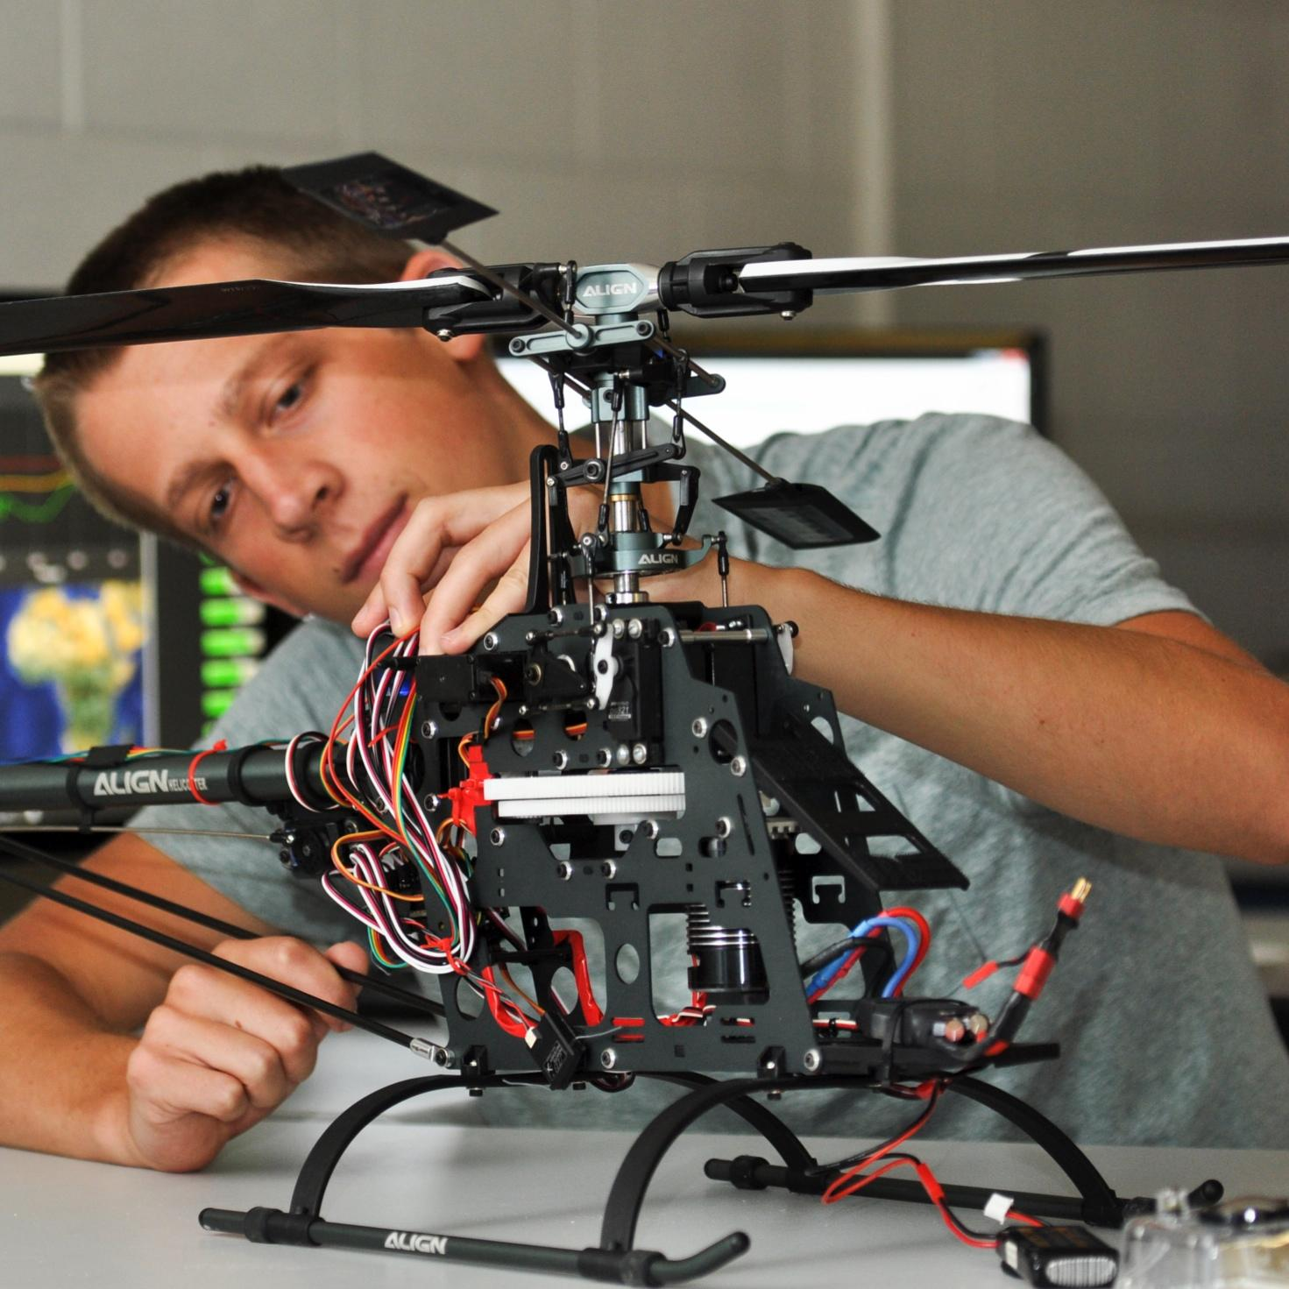

TMEIC DI-Water Cooling Skid
Bi-Weekly Update 2
Ethan Henderson
Robert Parker
Noah Ovikian
Sponsor: TMEIC
TA: Jerry Xu
Notes:
Michelle

Slide 2
Project Summary
Problem Statement
TMEIC’s high-power VFDs rely on deionized-water cooling to protect inverter IGBTs from damaging heat. Using a full-scale cooling system for customer training is costly, cumbersome, and impractical, yet trainees still need realistic operating and troubleshooting scenarios.
Our Solution
We are designing and building a compact, temperature-controlled DI water cooling skid for TMEIC’s training facility. It will reproduce the behavior of the full-scale system, enabling accurate hands-on testing, diagnostics, and troubleshooting at a fraction of the scale, cost, and complexity.

Slide 3
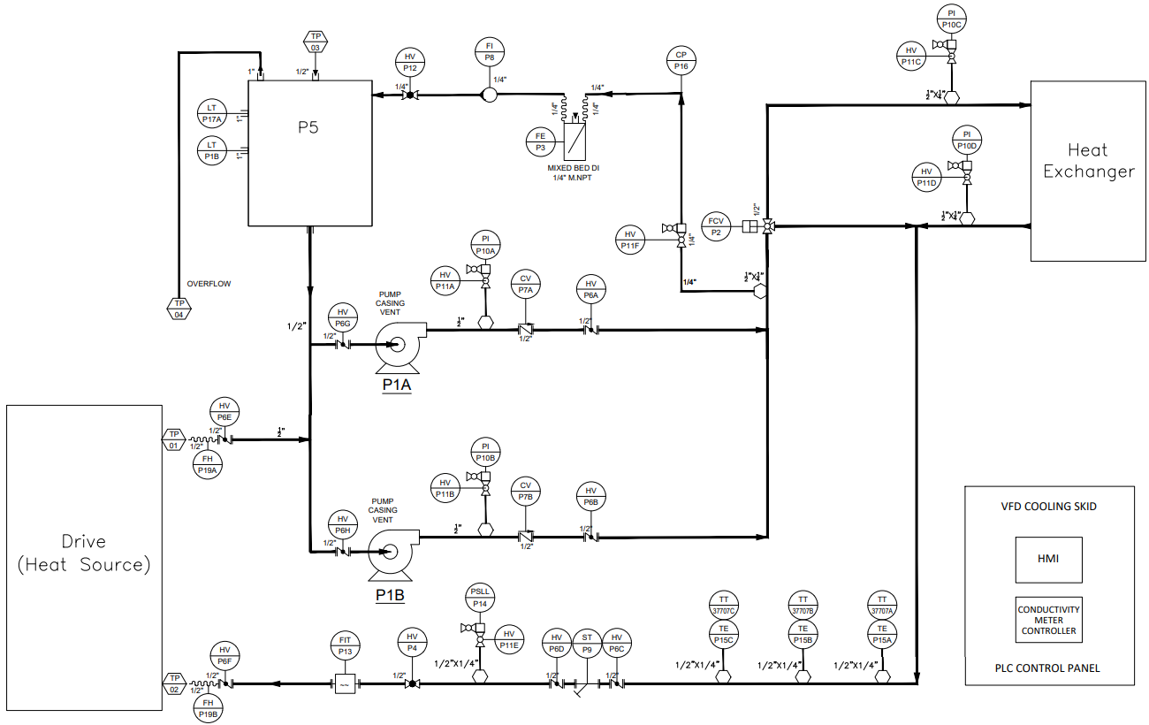
Project Summary

Slide 4
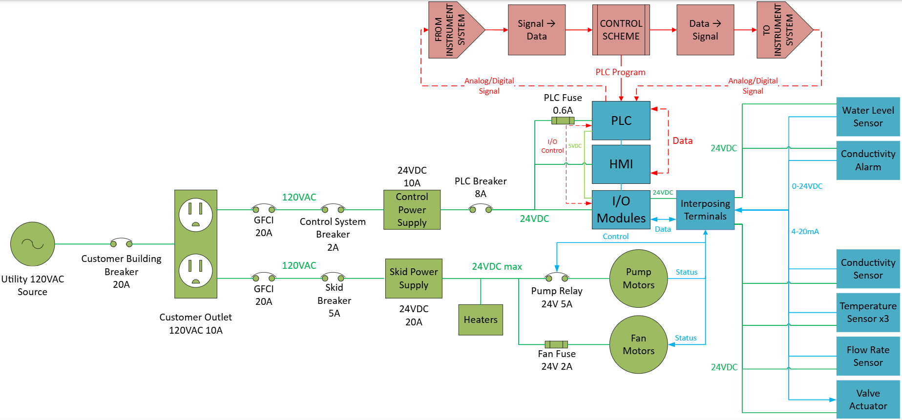
System Overview
Ethan Henderson
Robert Parker
Noah Ovikian

Slide 5
Phase I Timeline
AUG 29
Design Baseline Complete
Controls architecture & materials baseline set
SEP 14 – SEP 17
Phase I Electrical Equipment Received
SEP 24
Phase II Construction Start
SEP 10
SEP 17
AUG 29
SEP 10
Phase I Construction Start
Phase I items procured - target testing by 9/17
SEP 14
SEP 17 – SEP 24
Phase I Testing Start
Pump Curve
Pump Power & Control
Flow Control & Measurement
Digital Twin Refinement
SEP 24
Complete
In Progress
Behind Schedule
Not Started
*Contains AI generated content*

Slide 6






Parts Ordering Status
Received
Pumps
Conductivity probe
Control System
RTDs
Pump Relays
Fan Relay
Power Switches
Current probe
Voltage probe
Pressure switch
3-way valve
Est. Delivery - 9/18
24VDC 10A PS
24VDC 20A PS
600mA fuse
1A fuse
DIN Rail
14 AWG wire
FEDC
J. Cain
Est. Delivery - 9/29
Flow meter
The Void

Slide 7
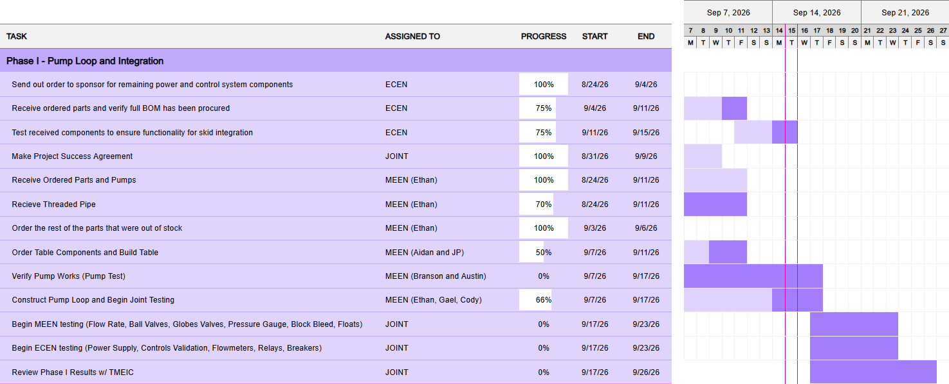
Execution Plan

Slide 8
Power | ECEN Team Lead
Accomplishments & Progress
Accomplishments (8/31 - 9/16) | In Progress (9/16 - 9/30)
Coordinated with FEDC on DI-water source water testing weekly Initiated work on Digital Twin to maximize testing efficiency - Control Software/MEEN Organized procurement of Power System and Control Hardware materials Established Gantt Chart to coordinate ECEN and MEEN responsibilities and action items Worked with MEEN TL to create a Project Success Agreement to define project expectations and to freeze scope expansions Adapted Skid Power system design to supply chain related design changes - Skid Power System will have dual power supplies | Continue working to provide clarity on project-class requirements and expectations Develop temporary alternatives in light of supply chain delays Negotiate for more dedicated time for water testing each week Position ECEN group in preparation for Phase I testing and Phase II construction Receive power supplies and connect them with their corresponding loads with temporary wiring arrangement Run load test with existing loads and monitor the new power supply’s voltage regulation Complete Phase I testing and present findings to TMEIC

Slide 9
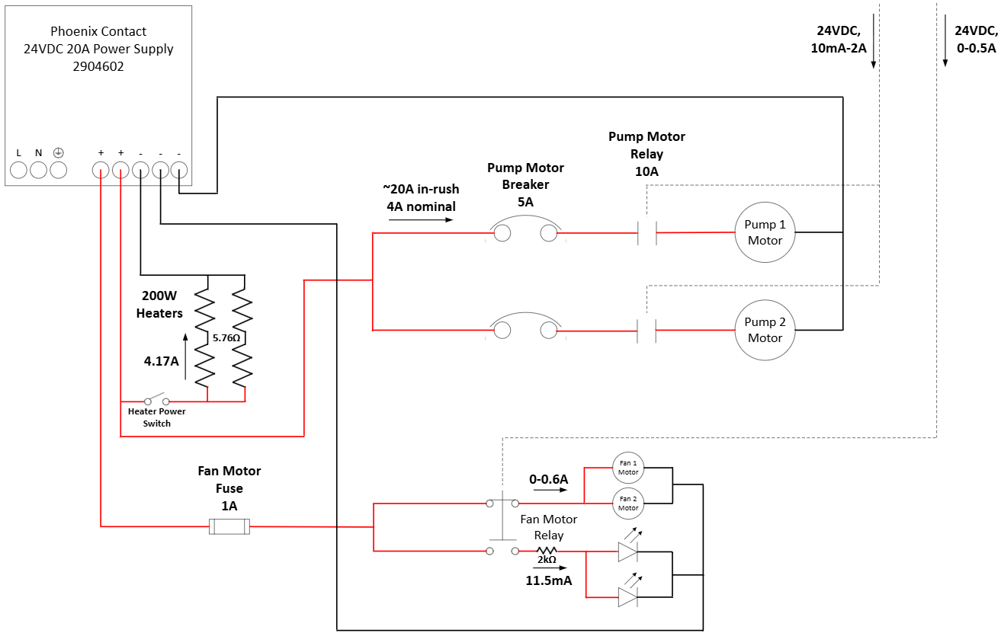
Power System
The revised design reduces cost without compromising critical pump reliability by segregating standard loads onto the lower-cost 20A supply and the pump onto the higher-quality 10A supply.

Slide 10
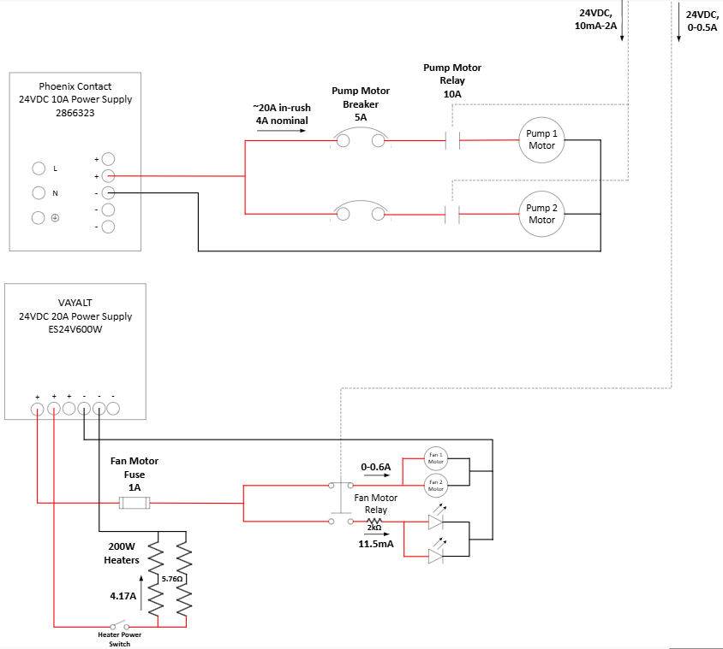
Power System
The revised design reduces cost without compromising critical pump reliability by segregating standard loads onto the lower-cost 20A supply and the pump onto the higher-quality 10A supply.

Slide 11
Control Hardware
Accomplishments & Progress
Accomplishments (8/31 - 9/16) | In Progress (9/16 - 9/30)
Selected Power Monitor transmitters and valve actuator Re-selected pressure switch and flow transmitter to reflect changes in MEEN specifications Ordered remaining parts with sponsor | Refactor HMI screens Update to include data marked on a simplified P&ID Update variable addresses to match new PLC Program Phase 1 build and test Install float switches to reservoir Test Control of Pumps via digital out to relays Test Flow Meter with Phase 1 build (Blocked until flow meter arrives)

Slide 12
Control Hardware
Parts Procurement
Component | Part number | Procurement Status | (Re)specified since last presentation
Flow Transmitter | RCM 3/4"-73-R-6-W3 | Estimated 9/29 | Yes
Pressure Switch | B420B15 | Received | Yes
Conductivity Meter | CM442R-AAM1A2F21+SA# | Received | No
Current Meter | CR5220-20 | Received | Yes
Voltage Meter | VDCT050-42-24 | Received | Yes
Valve Actuator | Valworx 563706 | Received | Yes

Slide 13
Control Software
Accomplishments & Progress
Accomplishments (8/31 - 9/16) | In Progress (9/16 - 9/30)
Digital Twin Reboot Reconstructed model with upgraded components for accuracy Simulated multistage controller for integration prep PLC Logic Updates Added pump cycling and usage tracking per MEEN request Updated controller to multistage per sponsor request Implemented controller hysteresis filter due to initial simulation Added comments to code! Documentation Creation Created Control Narrative (Rev A) for scope alignment | Digital Twin Refinement Work w/ MEENs to further improve model accuracy Continue virtual simulations for additional test preparation PLC Logic Adjustments Create additional startup phase (anticipation of transients) Adjust per virtual and physical simulation results Continued Integration (ELEN & MEEN) Establish MODBUS Comms. w/ PLC Vars. & HMI Test Pump Switching, Vessel Level Logic, & Flow* Observation Documentation Revisions Finish Rev B of Control Narrative & Finish PLC Point List (Rev A)
*Currently awaiting flow meter delivery - physical testing may be pushed

Slide 14
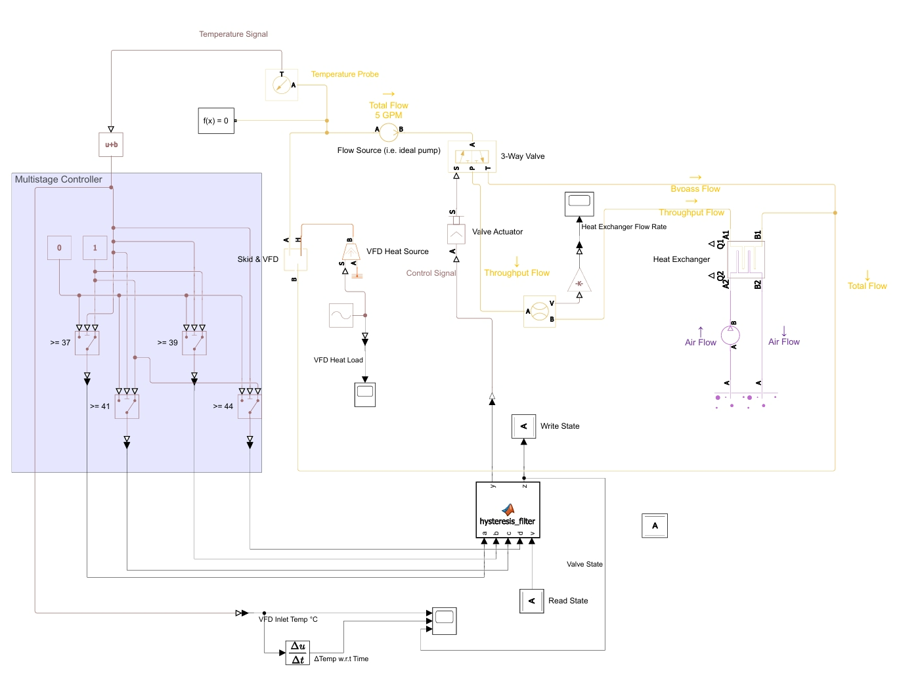
Control Software
Digital Twin Simscape Model
Rudimentary Simscape Model (Digital Twin) of Cooling Skid
Removed Artificial Flow Control, Pipe Mechanism, PI Controller
Added Constant Volume Vessel (“plant” in system), 3-way valve, heat exchanger, valve actuator, digital logic multistage controller w/ hysteresis filter
Figure CS.1: Current Digital Twin Simscape Model. Orange = Heat Circuit, Purple = Gas Circuit, Yellow = Thermal Liquid Circuit, Brown = Physical Signals, Black = Simulink Signals

Slide 15
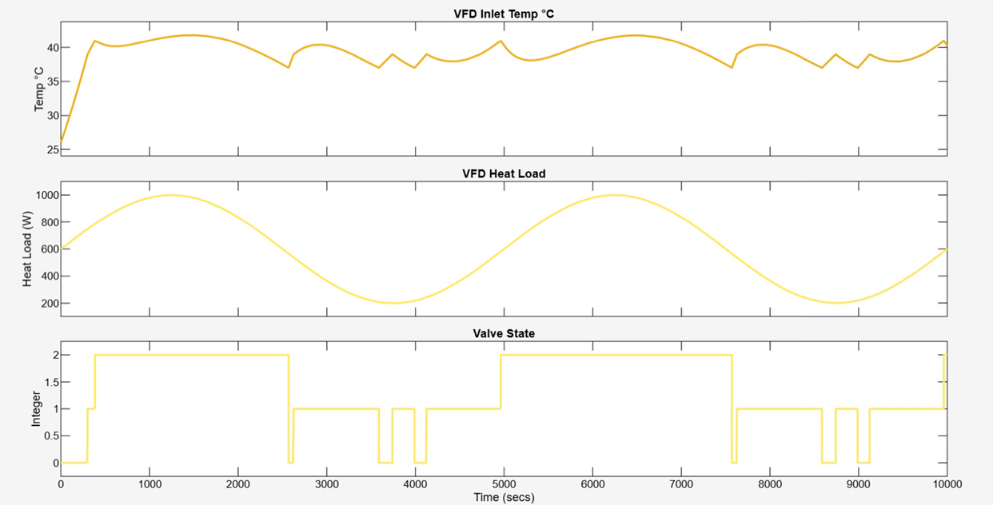
Control Software
Current Simulation Results
Consistent Temperature Control Over Variable Heat Load
General behavior confirmed w/ MEEN
Change to existing assumptions & ideals (head loss, orifice size, exchanger efficiency) may alter results
Figure CS.2: Temperature (°C), Valve state and VFD Heat Load(W). VFD Heat Load is independent variable, a 400W sinusoidal signal at 0.0002 Hz with a 600W bias. Simulation time is 10000 seconds.

Slide 16
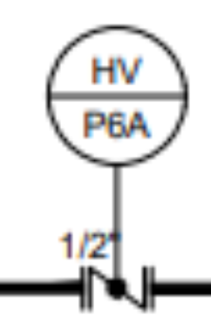
MEEN Integration
Phase I
DI Water
Tank
Bucket

Slide 17
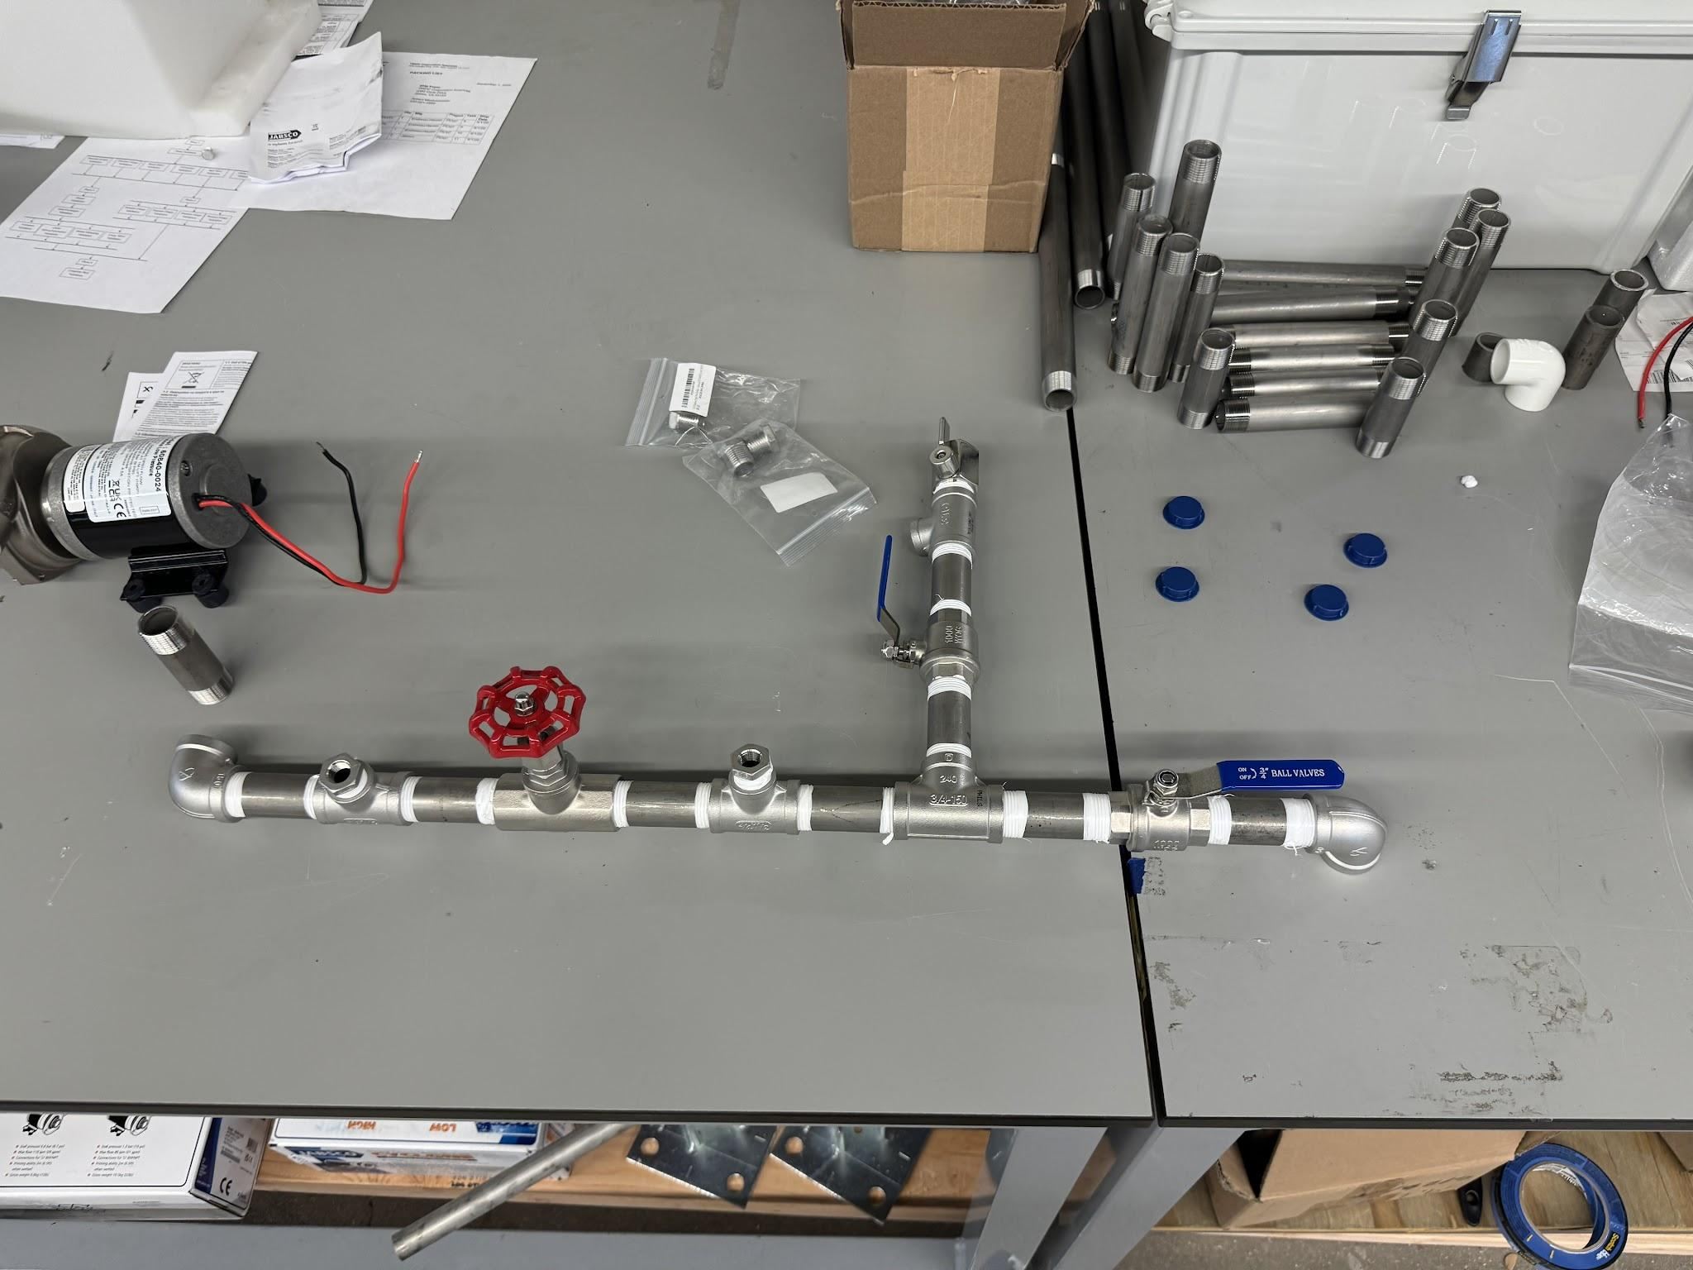
MEEN Integration
Phase I

Slide 18
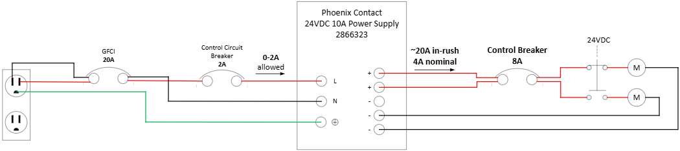
MEEN Integration
Phase I

Slide 19
Thank You

